Slide 1
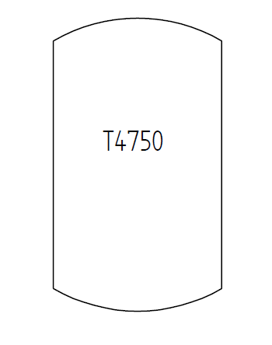
Test Case C06V01 – Tank in PlantStructure
A tank with tag name T4750
that is part of a PlantSectionIso10209-2012 with name „Section-1001“
that is part of a ProcessPlant with name „ABC Plant“
that is part of a SiteIsa95 with name „DEXPI Site“.
The tank is also located in a PlantTrain with name „Train 2“.

